Slide 1
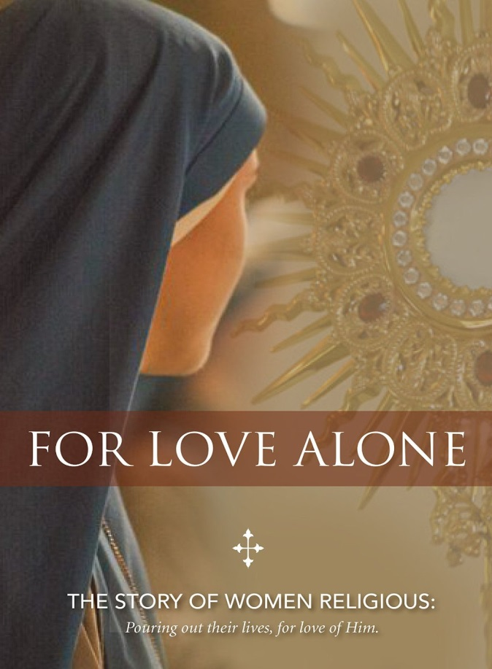
For Love Alone
The Story of Women Religious
Grades 5-6

Slide 2
Preparation
Read the story of the woman who anointed Jesus (Mark 14:3-9)
Why did she “waste” a whole jar of perfume on Jesus? Was it a waste?
Who complained that this gift she gave should have been given to the poor?
When a Sister enters a religious community, many people think she is wasting her life. What do you think?

Slide 4
Vocabulary
Vocation – a call from God to follow Him in a specific manner that takes all of the love and energy you have and is best for your happiness.
Religious life – a form of life where a man or woman vows chastity, poverty and obedience to God, lives in a community and serves the Church in an apostolate.
Apostolate – a form of service in the Church (teaching, nursing, social work, etc.)

Slide 5
Vocabulary
Vow – a solemn, life-long promise made to God or another person.
Chastity – the vow that says I give my deepest love to God in an exclusive way.
Poverty – the vow that says I will not own any goods on earth because I have the treasure of living for God.
Obedience – the vow that says I will choose freely to obey God through the authority of a superior/leader of a community.

Slide 6
Questions to Consider
Why does someone become a Sister?
What kind of families do Sisters come from?
Why did one Sister wonder if Jesus would be “enough?” What do you think she meant by that?
What apostolates did you see the Sisters engaged in?
How is a religious community like a family?
Do Sisters need to give up their love and desires when they become Sisters?
(watch video, then discuss questions)

Slide 7
My Vocation
A vocation is a call from God. Every human person is called to holiness, but also has a specific vocation. Many of you will be called to be married, but some of you will be called to be priests or Sisters.
You don’t need to know your vocation right now, but it’s never too early to start praying about it and asking God what He wants for you!

Slide 8
Prayer and Journal
Close your eyes and picture Jesus. Imagine you are sitting next to Him. He puts His arm around you and looks into your eyes with love. Take a few minutes to just soak in His love. Then ask Him what vocation He has in mind for you. Just listen first, then feel free to ask Him questions. Close your time by quietly resting your head on His chest and just listening to His Heart.
Journal for a few minutes and describe what your prayer was like.

Slide 9
Activity
Look online at the CMSWR website showing a list of religious communities in the US. https://cmswr.org/about/member-communities/
Choose one community and write to them, asking 3-5 appropriate questions.
Share with them what you thought of the video and thank them for giving their life to Jesus and His Church.

Slide 10
Closing Prayer
Options:
Sing a verse of: Open My Eyes, The Summons, Servant Song, Song of a Servant, Here I Am Lord, Give Me Ears to Listen, etc.
Lead a spontaneous prayer asking that our hearts will be open to respond to Jesus’ call to us.
Pray the short prayer: “Jesus, please tell me what You want me to do with my life and I will do it.”

Slide 11
Copyright 2017 Council of Major Superiors of Women Religious

